Slide 1
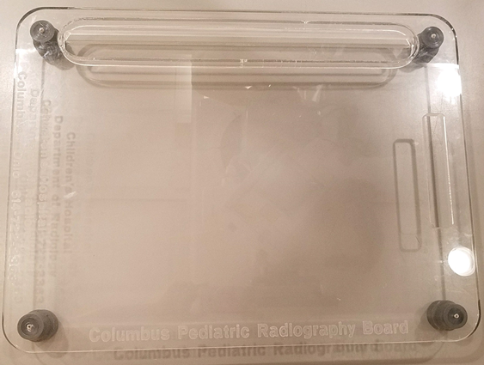
Columbus Board Nationwide Children’s Hospital

Slide 2
Columbus Board
Replaced the Pig-o-Stat at NCH
Developed by staff at NCH
Used primarily for chest/abdomen imaging
Allows for minimal patient movement between projections
Notes for positioning on page 5

Slide 3
Patient Positioning-AP
Patient lays supine on Columbus board
Utilize a baby blanket or pillowcase wrapped around the patient’s knees and tape to immobilize your patient for the exam
Cassette/detector slides under board easily with minimal patient discomfort or movement

Slide 4
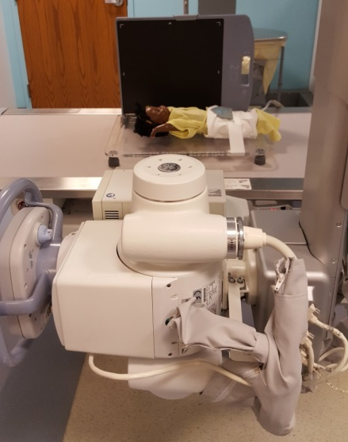
Patient Positioning-Lateral/Decub
Slot on side of board allows for cassette placement for x-fire/decub imaging
Use cassette holder for digital detectors that will not fit in slot
Patient will remain in same position on Columbus board
Move tube and detector for x-fire/decub imaging

Slide 5
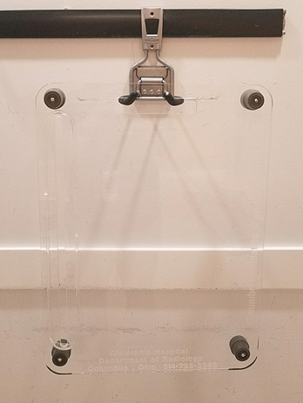
Notes
Artifact Notes:
Slot on side and handle slot on top of board will show up on x-rays if in the field of view
Screws from rubber feet will show up on
x-rays if in the field of view
Always position the handle slot at the patients feet → this is for patient comfort as well as to decrease artifacts on images.
Storage:
The handle slot at the top allows for the board to be hung when not in use

