Slide 1
Steps for creating and shipping scrolls:
Measure length and width (in mm) of tissue specimen contained within paraffin block.
Double click on excel table below to open editing function.
Enter tumor length and width values measured in step 1.
Number of 10 micron scrolls required is shown in yellow.
Put scrolls in tube for shipping (Eppendorf or cryovial)
Ship immediately to the BCR ambient (please contact for airbill)
Examples for measuring tumor area are on next slide.
“Double Click” below to activate table
………………..……………………………………………………………………………………………………………………………………..

Slide 2
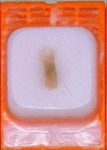
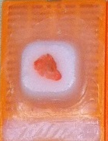
Example #1
Example #2
Length
=12mm
Length
=8mm
Width
=4mm
Width
=8mm
To calculate the number of 10uM thick scrolls…. = 12 / (0.01 * L * W)
Total surface area to be cut (mm³)
Scroll thickness (mm)
Tissue Length (mm)
Tissue Width (mm)
Example #1 Answer –
12 / (0.01 * 12 * 4) = 25 Scrolls
Example #2 Answer –
12 / (0.01 * 8 * 8) = 19 Scrolls

